Slide 1
All about the University of Georgia
By Jackson

Slide 2
School History
The school was founded on Jan 27, 1785
For the First 16 years it only EXISTED ON PAPER
1806 WAS THE YEAR IT WAS Completed
Women WERE NOT Admitted until 1916

Slide 3
ACADEMICS
THERE ARE OVER 600 STUDENT CLUBS AND ORGANIZATIONS
170 STUDY ABROAD PROGRAMS
THE SHORTEST CLASS IS 50 MINUTES
THE LONGEST CLASS IS 75 MINUTES
THE SCHOOL OFFERS 20 ACADEMIC PROGRAMS TO MAJOR/MINOR IN
ADMISSION REQUIREMENTS: ACT SCORE OF AT LEAST 21, A WRITTEN ESSAY, LETTERS OF RECOMMENDATION, AND INVOLVEMENT IN EXTRACURRICULAR ACTIVITIES

Slide 4
POPULATION
There are 389 buildings on 759 acres
There are 34,536 students going there now
It is the biggest school in George

Slide 5
SPORTS
The football team is ranked 13 in the country
NCAA division 1
38 national championships including 26 since 1999
Men’s sports include football, basketball, baseball, tennis, track and field, cross country and swimming
Women’s sports include basketball, cross county, equestrian, golf, gymnastics, soccer, softball, swimming and diving, tennis, track and field, and volleyball

Slide 6
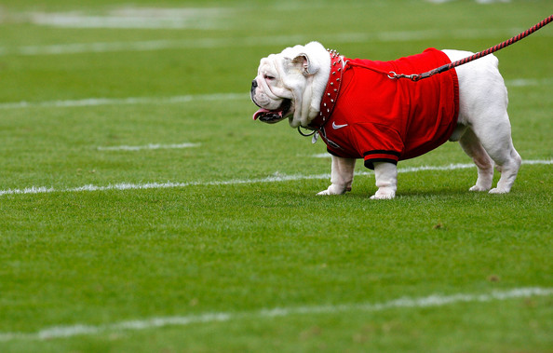
pictures

Slide 7
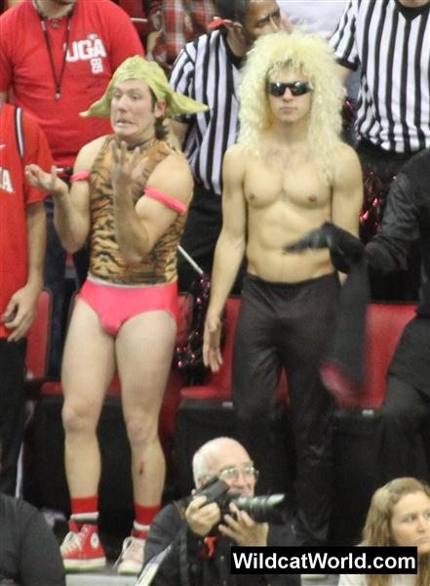
More pictures

